Slide 1
IEEE Central Texas Section 2018 Fall Leadership Planning Meeting August 25, 2018 San Marcus, TX
Section Committee/Officer Name: Jose Lacavex
Chapter/Affinity Name: Young Professionals
Prepared by: Jose Lacavex

Slide 2
2018 Key Accomplishments
Meetings (month, topic, L31):
September – Networking/Happy Hour @ ABGB Brewery
March – Networking/Happy Hour @ Scholtz Beer Garten
Other Activities/Events:
Student Outreach – “What they Don’t Tell You Before You Graduate”
SXSW 2018
IEEE Future Leaders Forum 2018
Planned: Leadership Workshop - How to Sell Yourself for a Job

Slide 3
2018 Chapter Vitality & Help Needed
Chapter Vitality Assessment (Strong, Ok, Need Improvement)
Attendance:
@ ABGB ~20+ - Strong
@ Sholtz Beer Garten ~10 – Ok, Needs Improvement
Membership Recruitment: - Needs Improvement
Student Interaction - OK
Social Media Outreach, Ideas:
Face Book Ads
Fan Pages
IEEE Videos
Help Needed
Speakers
Collaboration with STEM/Students/PACE/YP/Life Mem, …

Slide 4
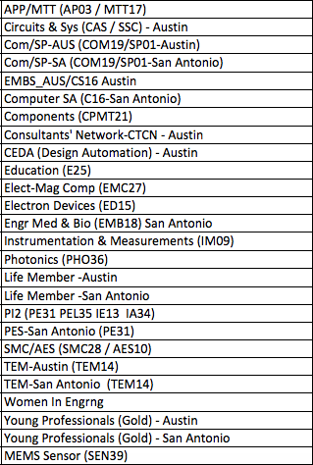
CTS Leadership
CTS Officers
Chapters/Affinity
Standing Committees/Coordinators
Chair
Fawzi Behmann
Vice Chair – A
Fabio Gomez
Vice Chair – SA
Ehsaneh Sunny Shahhaidar
Secretary
Raymond Choo
Treasurer
Bill Martino
Past Chair
Leslie Martinich
Past Past Chairs
Kenny Rice
Strategic Plan
Policies and Procedures PARP
Awards and Recognition
Membership Development
Electronics Communications
Website
vTools
Communications Portal
Conferences/Events
Section-Chapter Vitality Chair
Finance
K-12/STEM Educational Activities
Students Activities
Professional Activities – PACE
Outreach Program
Humanitarian

